Slide 1
8.2 - Structures and Processes of the Nervous System
Pages 349-362 (McGraw-Hill Ryerson, 2011)

Slide 2
Subtopics
Overview
Cells of the Nervous System
The Structure of a Neuron
Classifying Neurons
The Reflex Arc
The Electrical Nature of Nerves
Resting Membrane Potential
Sodium Potassium Pump (independent review)
Action Potential (animation support)
Myelinated Nerve Impulse
Signal Transmission across a Synapse
Neurotransmitters

Slide 3
Role of the Nervous system and how it works
To transmit information rapidly
The brain receives information about the environment and responds accordingly
Detection of stimulus → Processing in brain → Response in other part of body

Slide 4
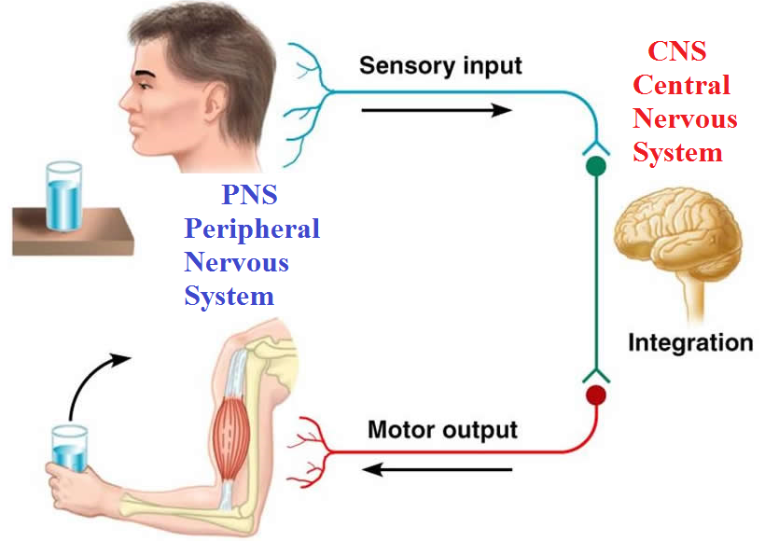
Overview:

Slide 5
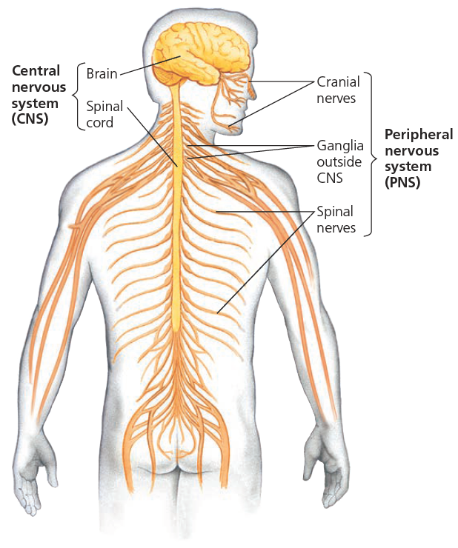
Overview
Central Nervous System
Network of nerves that includes the brain and spinal cord; integrates and processes information sent by nerves
CNS (Central nervous system): brain and spinal cord; integrates and processes information sent by the nerves

Slide 6
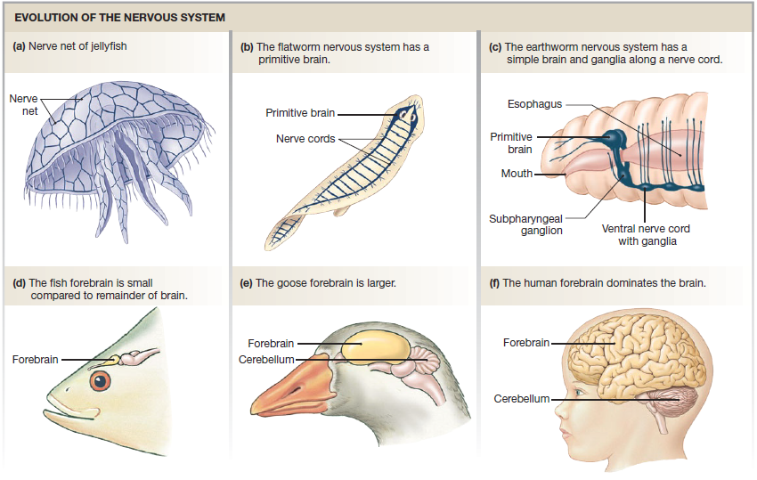

Slide 7
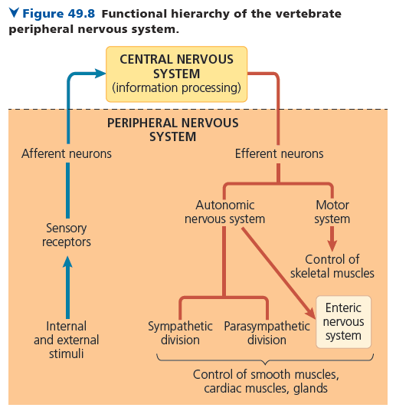
Overview
Peripheral Nervous System
Network of nerves that carry sensory messages to the central nervous system (CNS) and send information from the CNS to the muscles and glands; consists of the autonomic and somatic systems
Somatic system - conscious control
Autonomic system - not under conscious control
Notes:
We won’t be going into the enteric nervous system

Slide 8
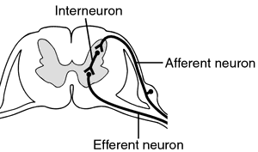
Afferent vs Efferent neuron
Afferent neuron = sensory neuron
Carries impulse to the CNS
Efferent neuron = motor neuron
Carries impulses from CNS to effectors
Interneuron = neuron carries impulse within the CNS
https://www.youtube.com/watch?v=FJ653ieC1yk&ab_channel=AnatomyHero

Slide 9
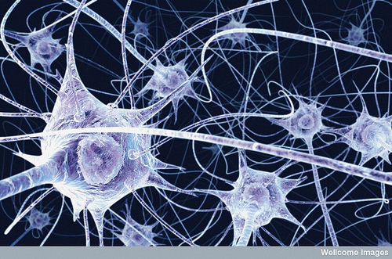
Neuron vs Nerve
Individual neurons are organized into tissues called nerves
Neuron: the structural and functional unit of the nervous system, specialized to respond to physical and chemical stimuli, to conduct electrochemical signals, and to release chemicals that regulate various body process

Slide 10
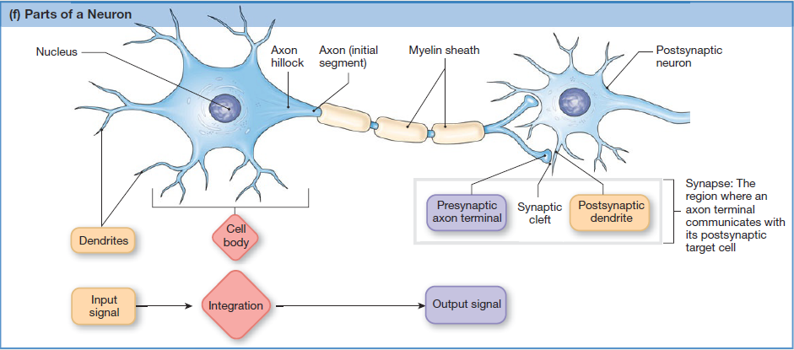
Cells of the Nervous System
Neurons
Nerve cell; the structural and functional unit of the nervous system, consisting of a nucleus, cell body, dendrites and axons;
Specialized to respond to physical and chemical stimuli, to conduct electrochemical signals, and to release chemicals that regulate various body processes

Slide 11
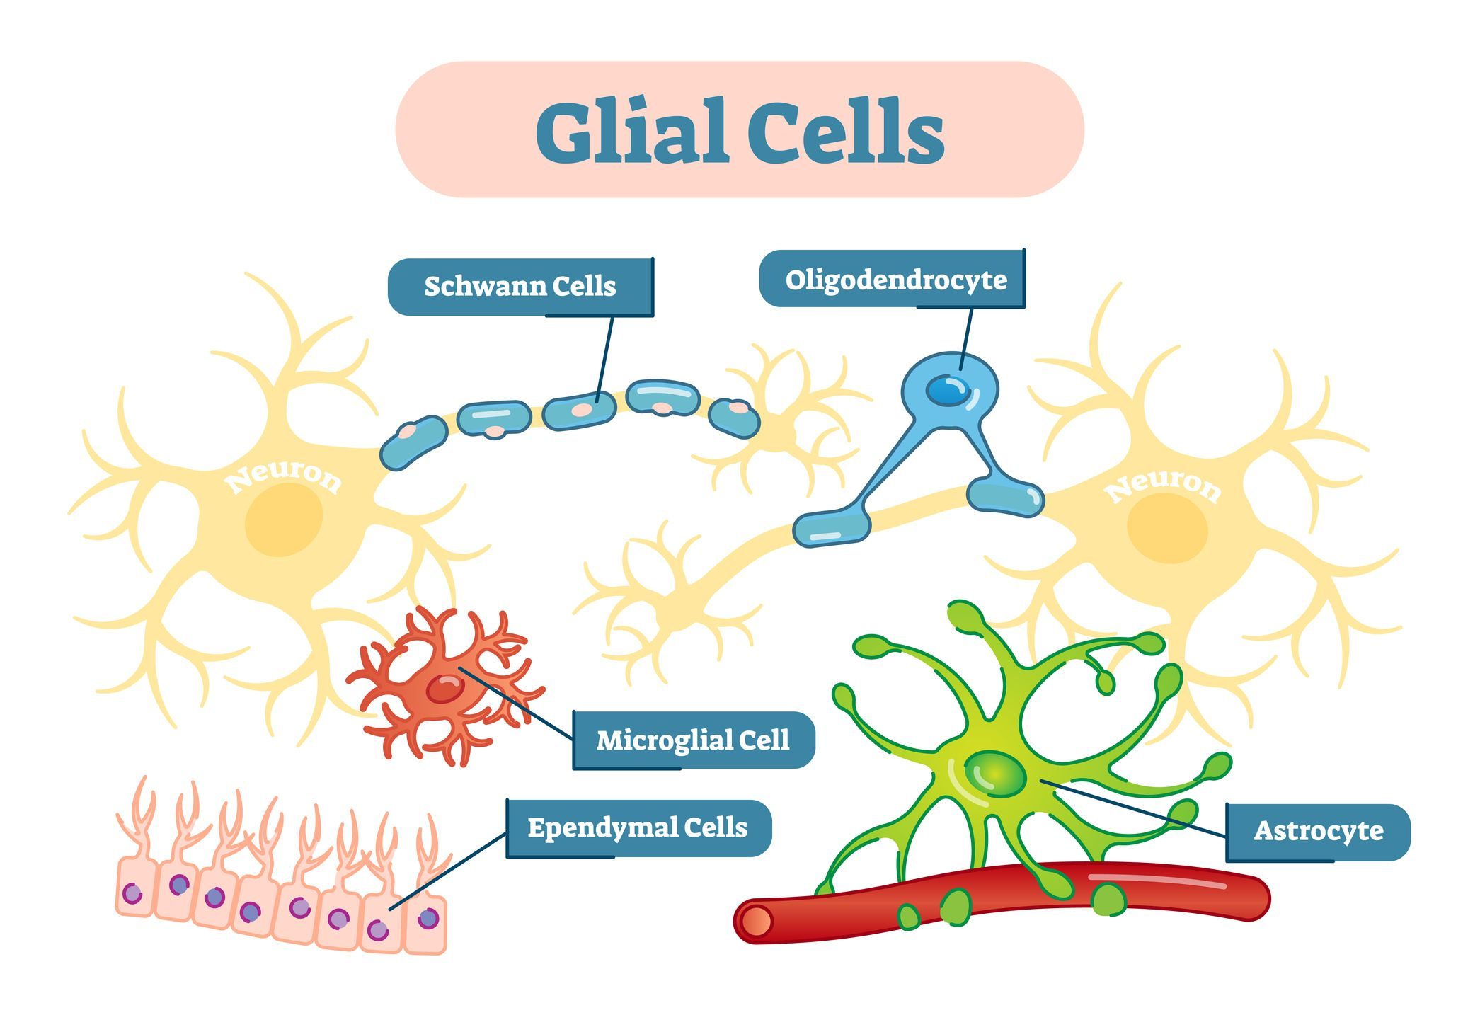
Cells of the Nervous System
Glial cells
Support cells of the nervous system that nourishes neurons (nerve-impulse conducting cells), removes their wastes, defends against infection, and provides a supporting framework for all the nervous-system tissue
Notes:
You do not need to know the specific types of glial cells. The graphic is there to illustrate how differentiated they are and how they are arranged in space

Slide 12
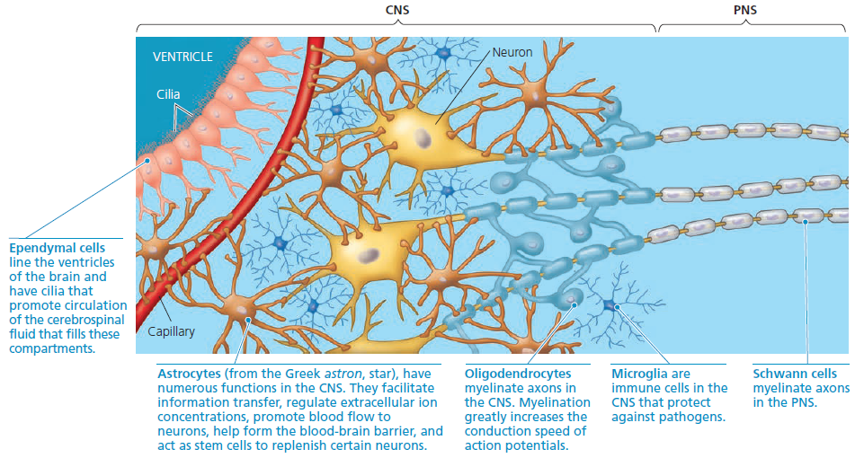
https://www.youtube.com/watch?v=64MgiEDWyRg&ab_channel=AnatomyZone

Slide 13
The Structure of a Neuron
Dendrites - short branching terminals that receive nerve impulses from other neurons or sensory receptors; relays the impulse to the cell body
Cell body - contains the nucleus and is the site of metabolic activity; processes information from dendrites and if the signal is large enough it will initiate an impulse through the axon
Axons - conducts impulses away from the cell body; can range in length from 1 mm to 1 m, depending on the neuron’s location in the body; terminal ends branch to their destinations
Notes:
Destinations could include dendrites of other neuronal cell bodies

Slide 14
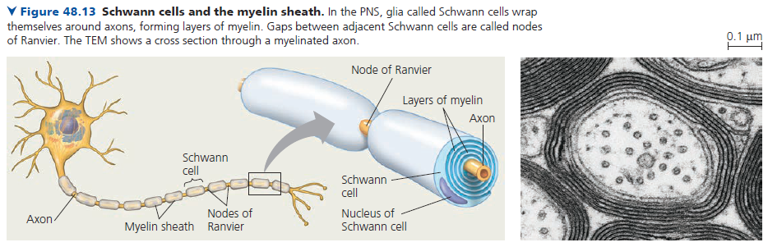
The Structure of a Neuron
Schwann cells
Generates myelin sheaths, the fatty, insulating layer around the axon of a nerve cell, composed of schwann cells; protects myelinated axons and speeds the rate of nerve impulse transmission
Notes:
Destinations could include dendrites of other neuronal cell bodies

Slide 15
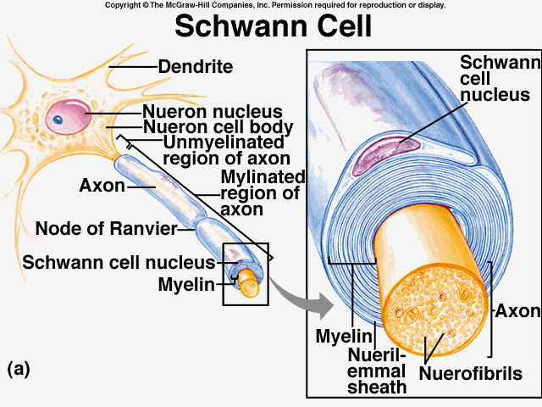
Schwann cells
Myelin sheath: insulated covering over the axon of a nerve cell (composed of Schwann cells)
Nodes of Ranvier: gaps between cells that wrap themselves around the neuron (speeding up the impulse)
Neurilemma: thin membrane surrounding axon of the PNS nerve cells (promote regeneration of damaged axons)

Slide 16
The Structure of a Neuron
Classifying neurons
Structure
Multipolar, Bipolar, Unipolar
Function
Sensory input, Integration, Motor output
Notes:
Destinations could include dendrites of other neuronal cell bodies

Slide 17
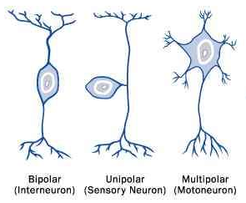
Types of Neurons
Bipolar:
-single main dendrite
-single axon
-In inner ear, retina of the eye and olfactory area of the brain ONLY
Unipolar:
-single process that extends from the cell body
-dendrites and axon are fused (so no dendrites)
-sensory neuron
Multipolar:
-several dendrites
-single axon
-most common
https://www.youtube.com/watch?v=X4uuCgElLK8&ab_channel=AnatomyZone
https://www.youtube.com/watch?v=HZh0A-lWSmY

Slide 18
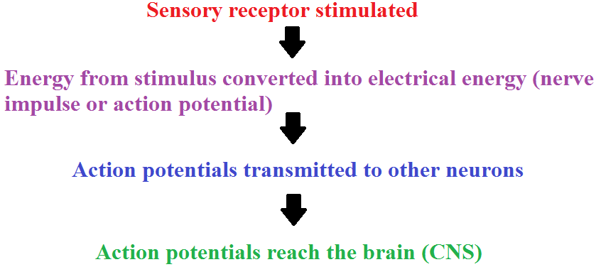
Transmitting sensory information

Slide 19
Motor output
The conduction of signals from integration centers to effector cells
Effector cells: The muscle, gland or organ cell capable of responding to a stimulus that carry out the body’s response to a stimulus

Slide 20
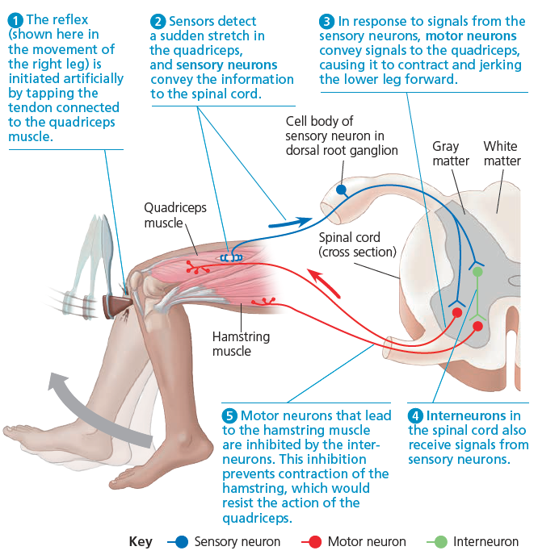
The Structure of a Neuron
https://www.youtube.com/watch?v=Nn2RHLWST-k&ab_channel=FuseSchool-GlobalEducation
The Reflex Arc
Reflexes - sudden, involuntary responses to certain stimuli
Reflex arcs
Simple connection of neurons that results in a reflex action in response to a stimulus; bypasses voluntary control
Usually only requires 3 neurons
Examples
Hot surface, blinking, vomiting
https://www.youtube.com/watch?v=QSXzzszM93Q&ab_channel=KnowledgePlatform

Slide 21
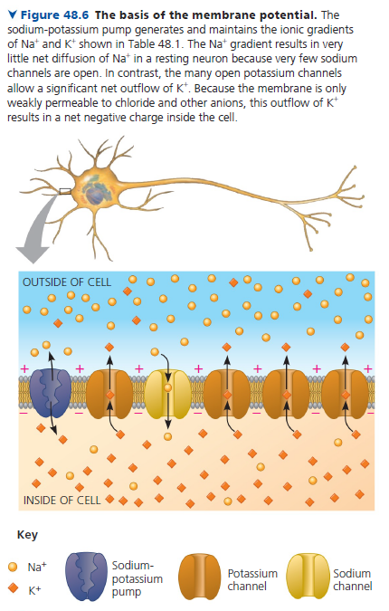
The Electrical Nature of Nerves
Membrane Potential
Electrical charge separation across a cell membrane; a form of potential energy
Resting Membrane Potential
Potential difference across the membrane in a resting neuron
-65 to -70 mV (millivolts) in most unstimulated neurons
Relatively negative in the cytoplasm

Slide 22
*The Electrical Nature of Nerves
**What makes it more negative inside?
Large negatively charged proteins located inside the cell (can’t diffuse out due to size)
The sodium potassium pump moving 3 Na+ ions out and 2 K+ ions in (making the inside relatively more negative)
K+ ion channels allowing K+ to move along its gradient out of the cell (making the inside relatively more negative)

Slide 23
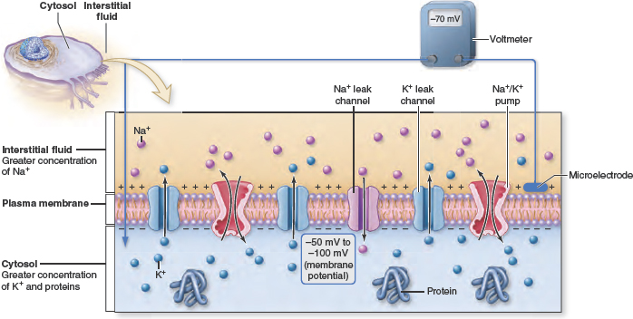
The resting potential
Negatively charged protein molecule stays inside and cannot diffuse out
At rest, there are relatively more sodium ions outside the neuron and more potassium ions inside that neuron.
http://www.youtube.com/watch?v=NCE8baQaiK8

Slide 24
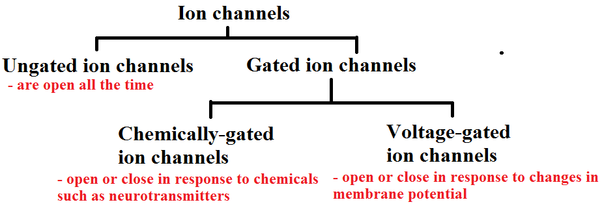
Excitable cells
Cells that can change their membrane potentials. Their cell membranes have ion channels to allow ions to pass through the cell membrane
Gated ion channels are made up of proteins that change their shape in response to certain stimuli, thus allowing ions to flow through

Slide 25
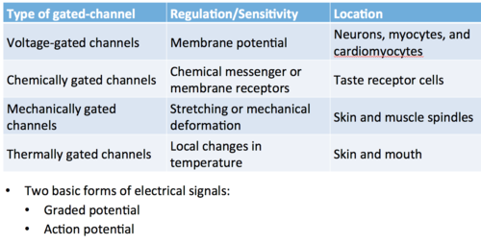

Slide 26
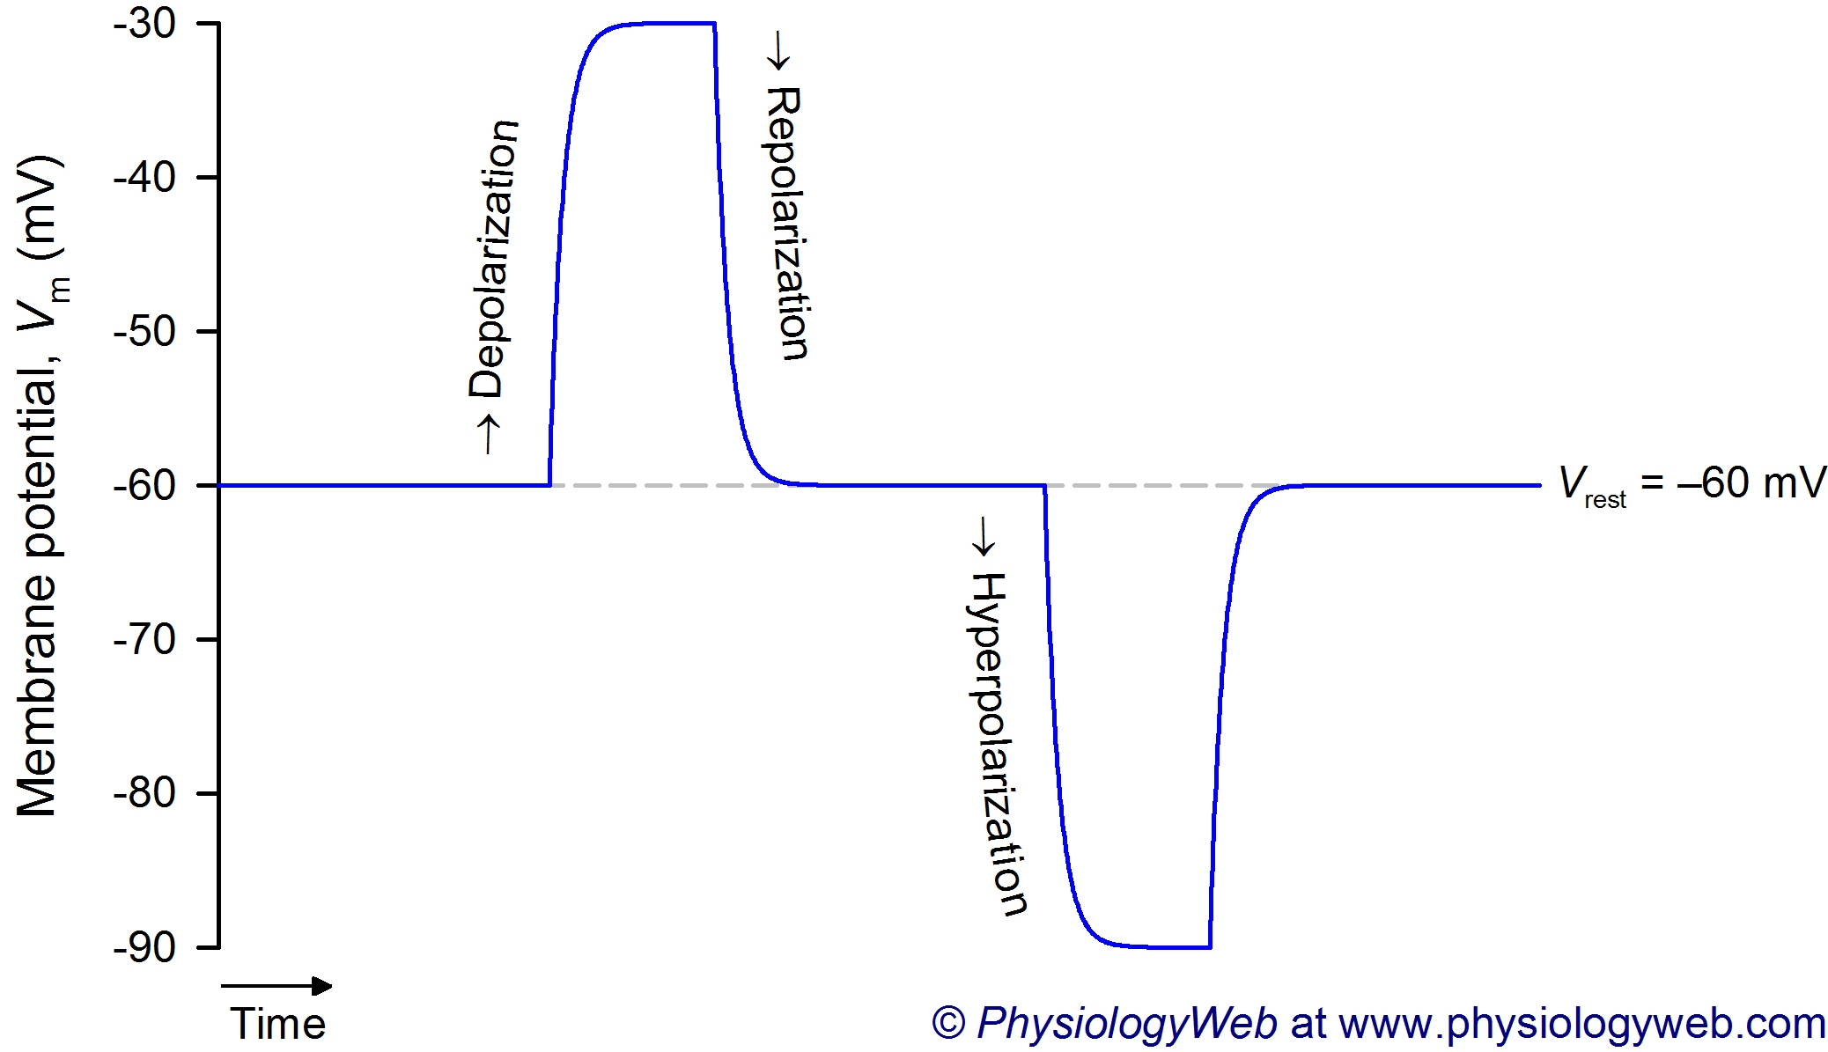
Hyperpolarization and Depolarization in Graded potentials
If K+ ions diffuse out of the cell, then the inside of the cell becomes even more negatively charged compared to the outside of the cell. This makes the membrane potential more negative and is known as Hyperpolarization
**Hyperpolarization can also result when chloride ion channels open because chloride ions will diffuse into the cell
If sodium ions diffuse into the cell, then the inside of the cell becomes more positively charge. This makes the membrane potential more positive and is known as Depolarization

Slide 27
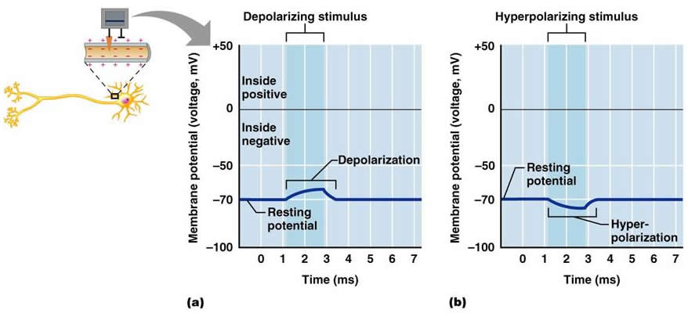
Hyperpolarization and Depolarization in Graded potentials
Stimulus open Na+ channel Stimulus open K+ channel

Slide 28
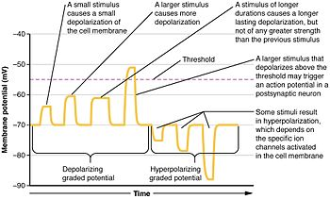
Graded potential vs Action potential
https://www.youtube.com/watch?v=j1c19vuKWV0&ab_channel=AnatomyandPhysiologyforParamedics

Slide 29
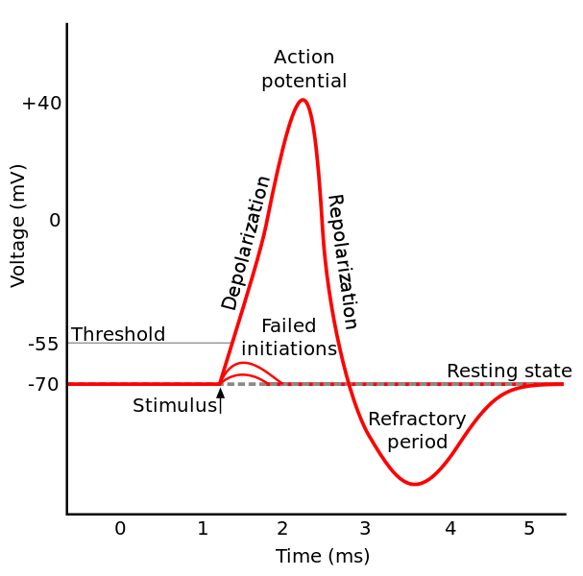
Hyperpolarization and Depolarization in Graded potentials
A graded potential is that a local change in membrane potential that occurs when a neuron is stimulated. The size of the change in membrane potential is proportional to the stimuli.
Stimuli of greater magnitude → more ion channels open → larger change in membrane potential → ACTION POTENTIAL

Slide 30
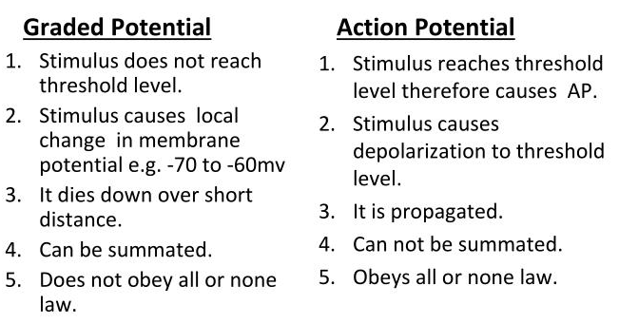
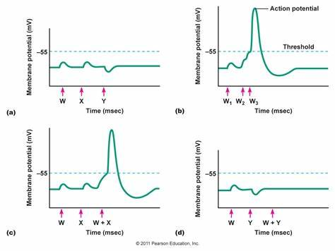
https://www.youtube.com/watch?v=kscvbU0GsQU&ab_channel=ChristineO%27Connor

Slide 31
Action potential
If the graded potential is a large enough depolarization, the membrane potential may reach ~50 – 55mV. This is known as the Threshold potential, the potential at which an action potential occurs
Action potentials are nerve impulses that are triggered in the axons of neurons
POSITIVE FEDBACK: When the membrane of an axon is depolarized in a graded potential to the threshold, an even larger depolarization (action potential) occurs

Slide 32
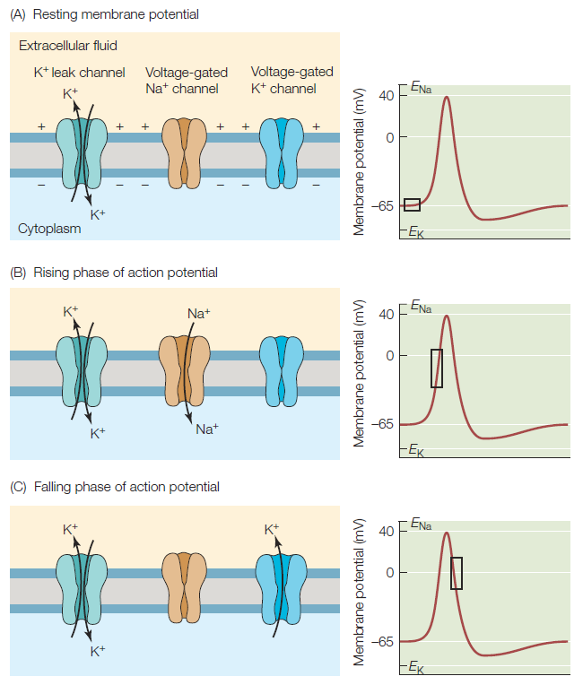
The Electrical Nature of Nerves
Action Potential
In an axon, the change in charge that occurs when the gates of the K+ channel close and the gates of the Na+ channels open after a wave of depolarization is triggered

Slide 33
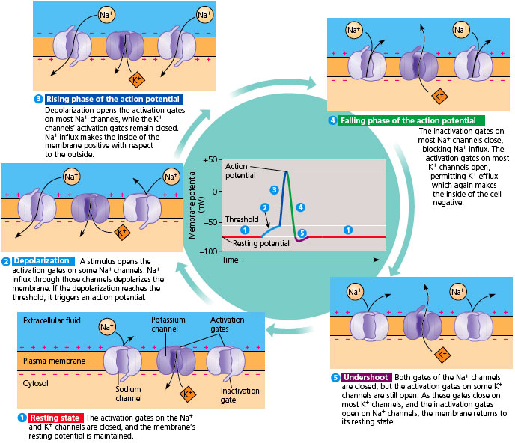
http://www.youtube.com/watch?v=U0NpTdge3aw
https://www.youtube.com/watch?v=HYLyhXRp298&ab_channel=BozemanScience

Slide 34
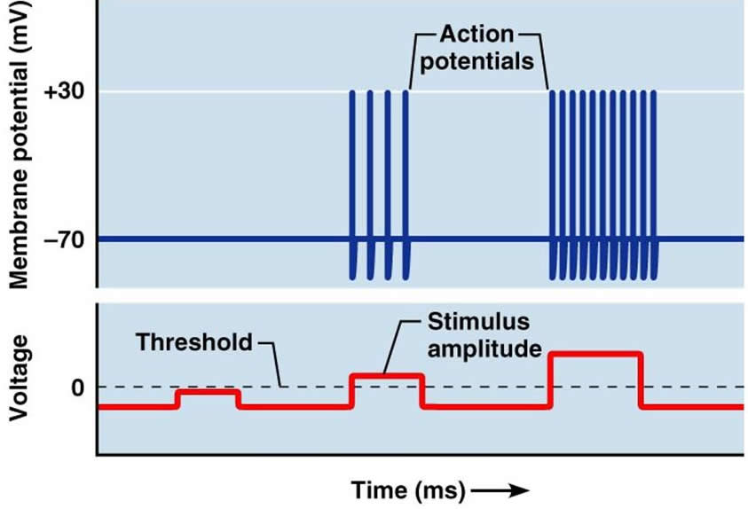
Action potential
Action potentials are an all-or-none phenomena: they either happen completely, in the case of a threshold stimulus, or not at all, in the event of a subthreshold stimulus.

Slide 35
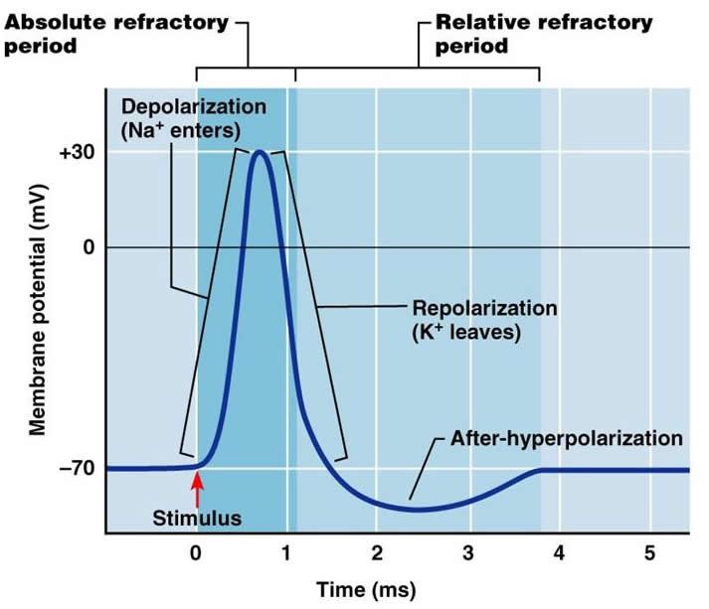
Action potential
Absolute and Relative Refractory Periods
Absolute – from opening of voltage gated Na⁺ channels until sodium inactivation gates close
-Cannot be stimulated at all during this time
Relative – period of repolarization (including hyperpolarization)
-Takes a stronger stimulus to depolarize the membrane enough to generate another action potential
-Na⁺ channels have to reset the activation gates
-K⁺channels have to close - they close more slowly than Na⁺ channels
The refractory period of an axon is related to the period of time required so that a neuron can generate another action potential.
http://www.youtube.com/watch?v=HnKMB11ih2o

Slide 36
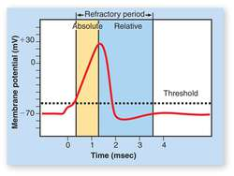
Action potential
Hyperpolerization makes it more difficult for a stimulus to excite a cell to the threshold potential
In a given neuron, the amplitude of an action potential is constant. All action potentials in a given neuron are identical
The neuron transmits information about the strength and duration of a stimulus by changing the frequency of action potentials. The amount of neurotransmitter released at the axon terminal is directly proportional to the frequency of action potential
If more neurotransmitters are released from the presynaptic cell, a larger graded potential occurs in the postsynaptic cell

Slide 37
Propagation of action potential
Movement of an action potential through the axon is called conduction or propagation – the flow of electrical energy from one part of the cell to another
The region in which the first action potential occurs is called the trigger zone

Slide 38
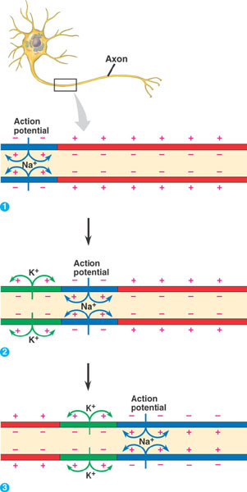
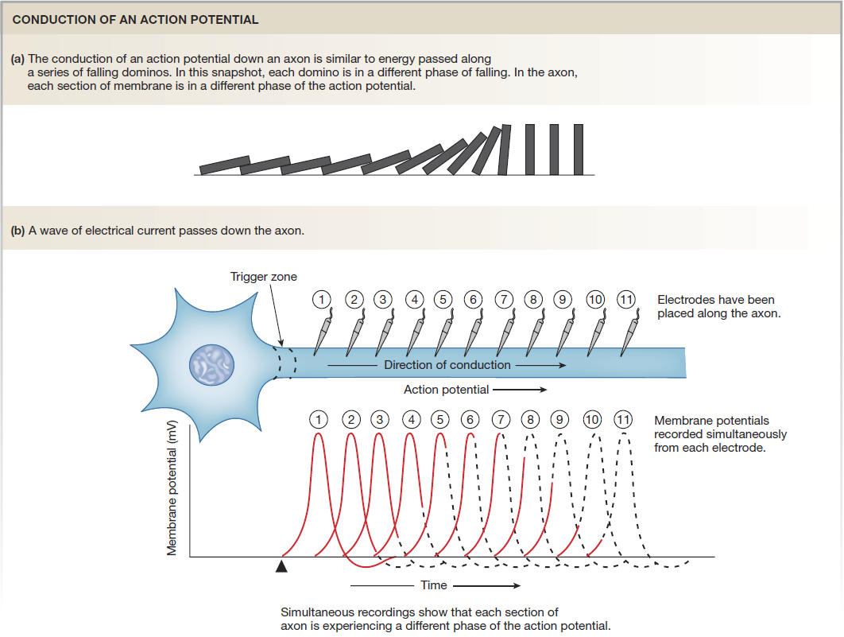
Propagation of action potential
The positive current from entry of Na+ ions during the first action potential spread through the cytoplasm in all directions
http://www.youtube.com/watch?v=pbg5E9GCNVE

Slide 39
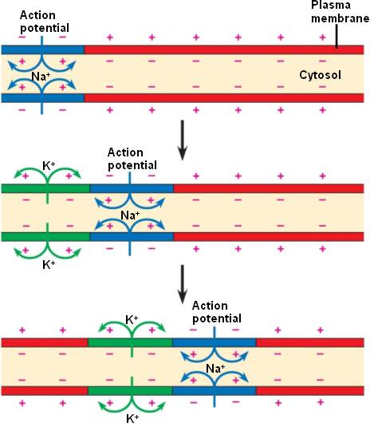
Propagation of action potential
Current that flows “backward” toward the initial segment of membrane will NOT affect the voltage-gated channels since they will still be in their refractory period

Slide 40
Propagation of action potential
Current that flows “forward” (toward the axon terminal) activates voltage-gated channels in the next portion of the membrane, resulting in another action potential

Slide 41
Propagation of action potential
The initial action potential at the trigger zone causes another action potential to occur in the next portion of the axon , and so on, until an action potential occurs at the end of the axon.
Initial action potential itself DOES NOT travel along the length of the axon
POSITIVE FEEDBACK LOOP:
Na+ Channels open → depolarization → more channels open → more depolarization

Slide 42
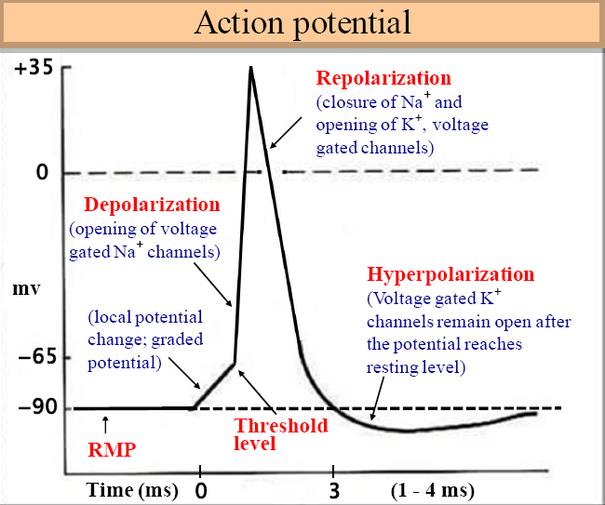
Review

Slide 43
Factors that affect the speed of conduction
1.) Diameter of the neuron: faster movement of action potential
2.) Myelination: myelination prevent current flow between the cytoplasm of the neuron and the extracellular fluid (decreased leakage of ions out of the cell)

Slide 44
The Electrical Nature of Nerves
Myelinated Nerve Impulse
Jumping the Nodes of Ranvier
Exposed areas on the myelinated axon at regular intervals
Instead of continuous depolarization, you have jumping depolarization
Also known as Saltatory conduction

Slide 45
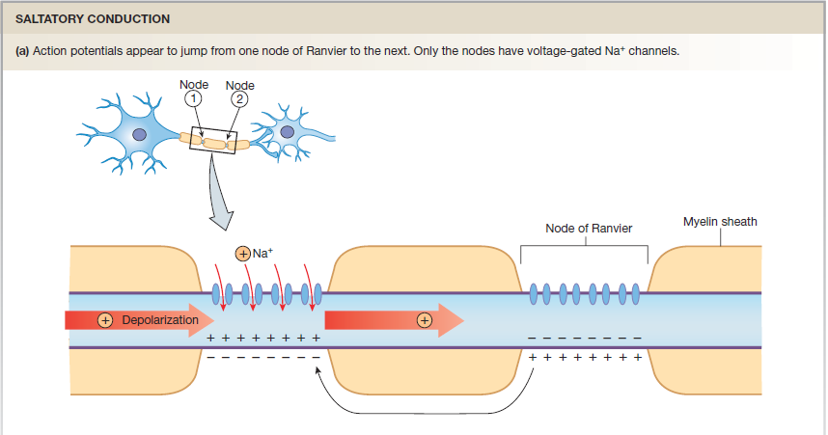
The Electrical Nature of Nerves
Myelinated Nerve Impulse

Slide 46
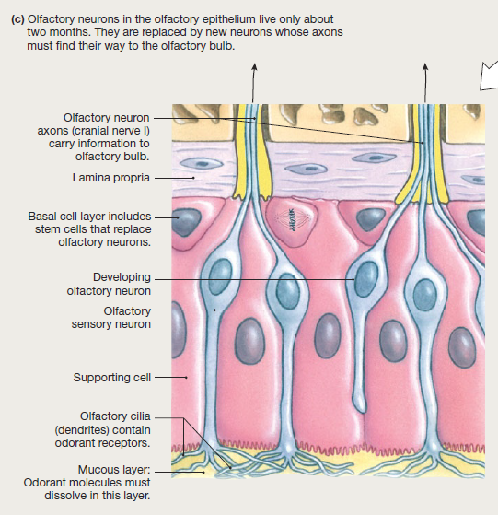
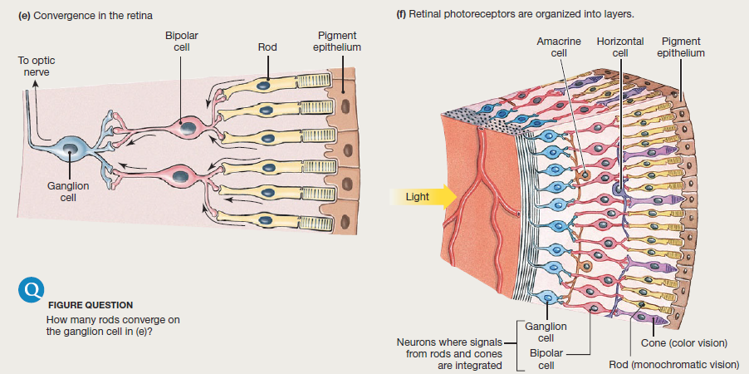
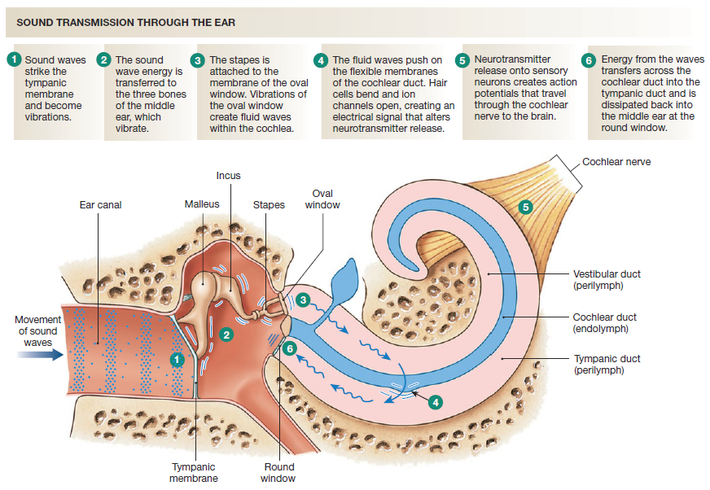
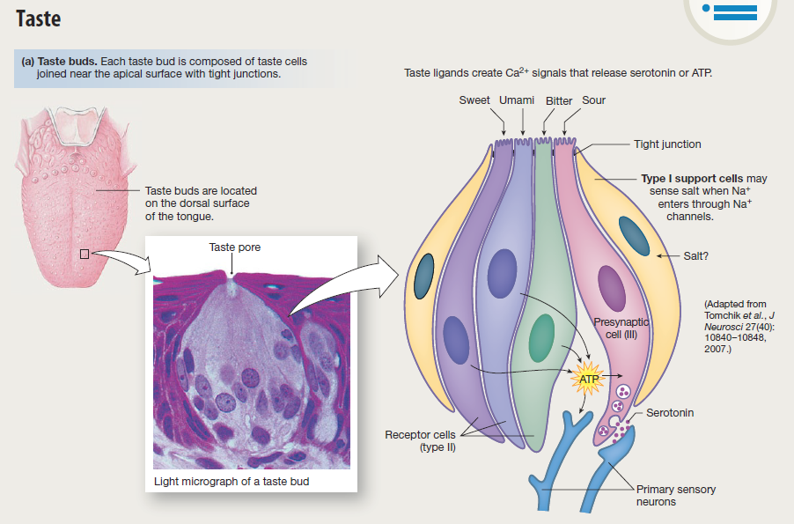
The Electrical Nature of Nerves
What causes the initial change in voltage in a sensory neuron?
There are a very wide variety of sensory receptors in the body that can initiate an action potential
https://www.youtube.com/watch?v=pDr6DDRHvUY&ab_channel=ProfessorDaveExplains

Slide 47
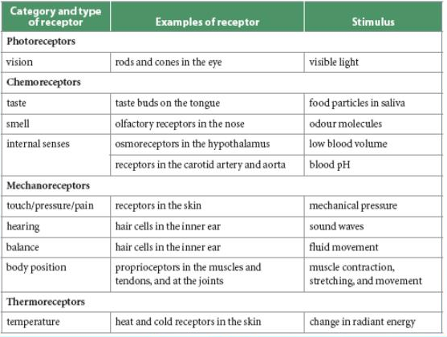
The Electrical Nature of Nerves
What causes the initial change in voltage in a sensory neuron?
There are a very wide variety of sensory receptors in the body that can initiate an action potential

Slide 48
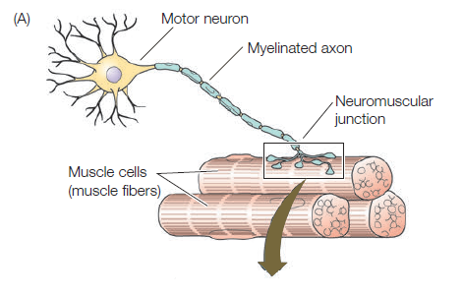
Signal Transmission Across a Synapse
Synapse
Junction between two neurons or between a neuron and an effector (muscle or gland)
Neurotransmitter
Chemical messenger secreted by neurons to carry a neural signal from one neuron to another, or from a neuron to an effector, such as a gland or muscle fibre

Slide 49
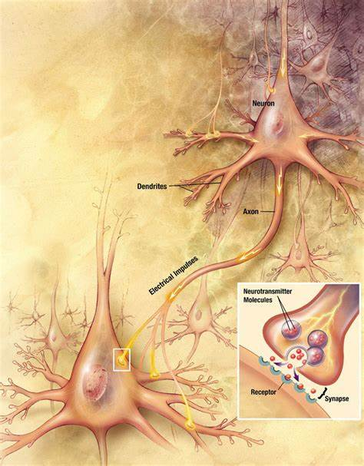
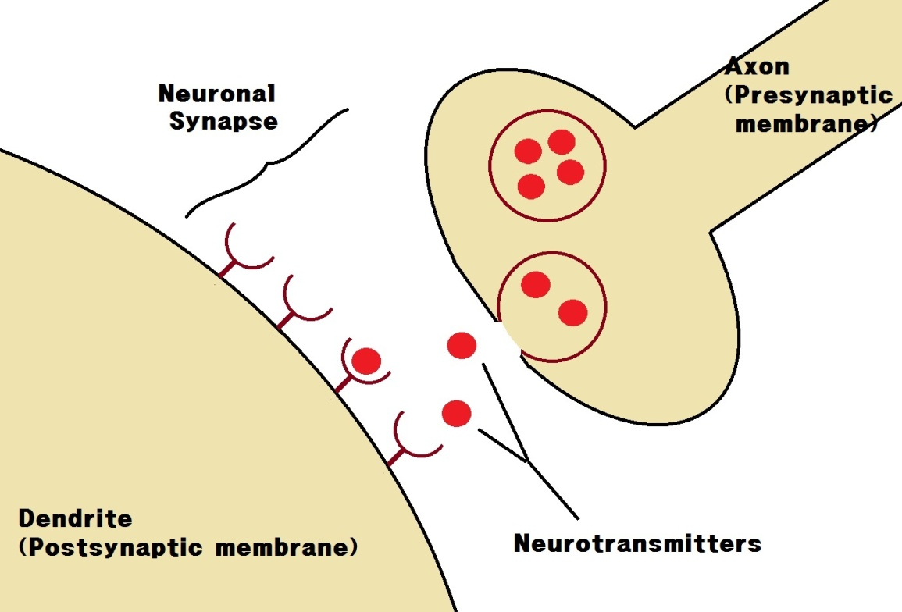
Other terminology
Synapses: the space between a presynaptic neuron and a postsynaptic neuron
Presynaptic neuron: release neurotransmitter
Postsynaptic neuron: has receptors for neurotransmitters

Slide 50
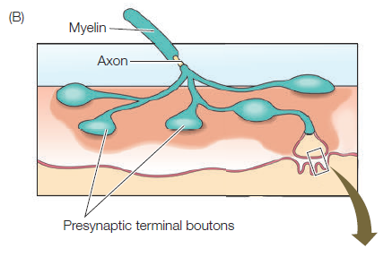
Signal Transmission Across a Synapse
Synapse
Junction between two neurons or between a neuron and an effector (muscle or gland)
Neurotransmitter
Chemical messenger secreted by neurons to carry a neural signal from one neuron to another, or from a neuron to an effector, such as a gland or muscle fibre

Slide 51
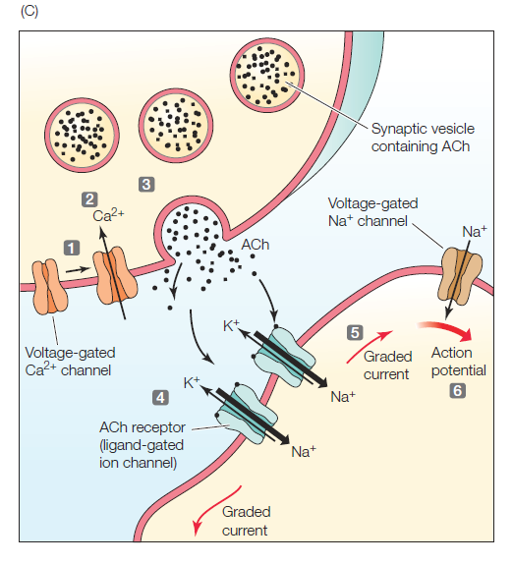
Signal Transmission Across a Synapse
Synapse
Junction between two neurons or between a neuron and an effector (muscle or gland)
Neurotransmitter
Chemical messenger secreted by neurons to carry a neural signal from one neuron to another, or from a neuron to an effector, such as a gland or muscle fibre
Notes:
In this example a neuromuscular junction is depicted (neuron to muscle cell)

Slide 52
Signal Transmission Across a Synapse
0.5 to 1 ms neurotransmitter travel time
Neurotransmitters will bind to specific receptor proteins
In some cases, ion-specific channels will open causing depolarization and if threshold is met a new action potential will be generated at the post-synaptic neuron
Example
Neuromuscular junction
Neuron to muscle cell
Animation
Notes:
In this example a neuromuscular junction is depicted (neuron to muscle cell)

Slide 53
Neurotransmitters
Either excitatory or inhibitory
Excitatory: trigger ion channels of positive ions on the postsynaptic cell (depolarization)
Inhibitory: trigger potassium channels to open, so potassium ions will flow out (hyperpolarization)
E.g. Acetylcholine: excites the muscle cell membrane by causing depolarization and contraction of muscle fibre
https://www.youtube.com/watch?v=L41TYxYUqqs&ab_channel=BozemanScience

Slide 54
References
Carter-Edwards, T., Gerards, S., Gibbons, K., McCallum, S., Noble, R., Parrington, J., Ramlochan, C., Ramlochan, S. (2011). Biology 12. McGraw-Hill Ryerson Limited
Silverthorn, D.U. (2013). Human Physiology: An Integrated Approach. Pearson Education Inc.
Hillis, D.M., Sadava, D., Hill, R.W., Price, M.V. (2014). Principles of Life . Sinauer Associates, Inc.
Urry, L.A., Cain, M.L., Wasserman, S.A., Minorsky, P.V., Reece, J.B., (2017). Campbell Biology (11th edition). Pearson Education, Inc.

